Slide 1
Week 3
Web site http://www.staff.city.ac.uk/~maylmer/web/homerichmond.htm
Point Filters
  Point filters work in 3D (tracking only works in 2D, to try tracking type tk when asked for position)
More drawings

Slide 2
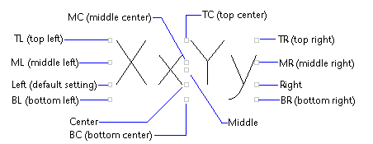
Point Filters
Point Filters
    Use Filters as a template drawing
    Redo the cube in Introduction slide 4 positioning the text correctly. Justify the text using M for Middle.
    Use 3DFilter as a template drawing
.x accept the x value of the next point
.xy accept the xy value of the next point.
Then you will be prompted for z value.

Slide 3
Individual Work
Finish
  The Cross, U bracket, Machine support
Then
  Drawings 3 and 4 from the U bracket sheet
  Backing plate
  CE/M/99
Sections covered
    3.2.1

